Slide 1
Doubly Linked Lists
The singly linked list allows for direct access from a list node only to the next node in the list.
A doubly linked list allows convenient access from a list node to the next node and also to the preceding node on the list.
The doubly linked list node accomplishes this in the obvious way by storing two pointers:
One to the node following it (as in the singly linked list),
Second pointer to the node preceding it.
The most common reason to use a doubly linked list is because it is easier to implement than a singly linked list.

Slide 2
Doubly Linked List
A doubly linked list can be traversed forward and backward
Nodes store:
element
link to the previous node
link to the next node
Special trailer and header nodes
prev
next
element
node
header
nodes/positions
trailer
elements

Slide 3
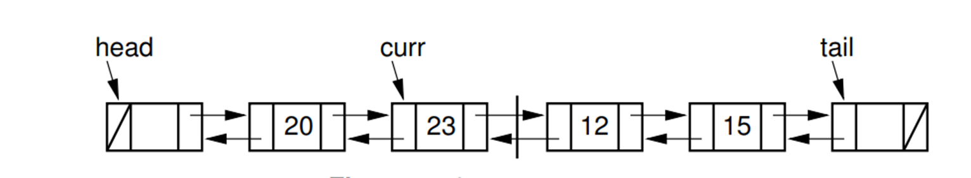
While the code for the doubly linked implementation is a little longer than for the singly linked version, it tends to be a bit more “obvious” in its intention, and so easier to implement and debug.
Like our singly linked list implementation, the doubly linked list implementation makes use of a header node.
We also add a trailer node to the end of the list.

Slide 4
The trailer is similar to the header, in that it is a node that contains no value, and it always exists.
When the doubly linked list is initialized, the header and trailer nodes are created.
Data member head points to the header node, and tail points to the trailer node.
The purpose of these nodes is to simplify the insert, append, and remove methods by eliminating all need for special-case code when the list is empty, or when we insert at the head or tail of the list.
For singly linked lists we set curr to point to the node preceding the node that contained the actual current element, due to lack of access to the previous node during insertion and deletion.

Slide 5
Since we do have access to the previous node in a doubly linked list, this is no longer necessary.
We could set curr to point directly to the node containing the current element.
However, we have the same convention for the curr pointer as we set up for singly linked lists, purely for the sake of consistency.
The Doubly Linked List code implementation is a little longer than that for the singly linked list node implementation since the doubly linked list nodes have an extra data member.

Slide 6
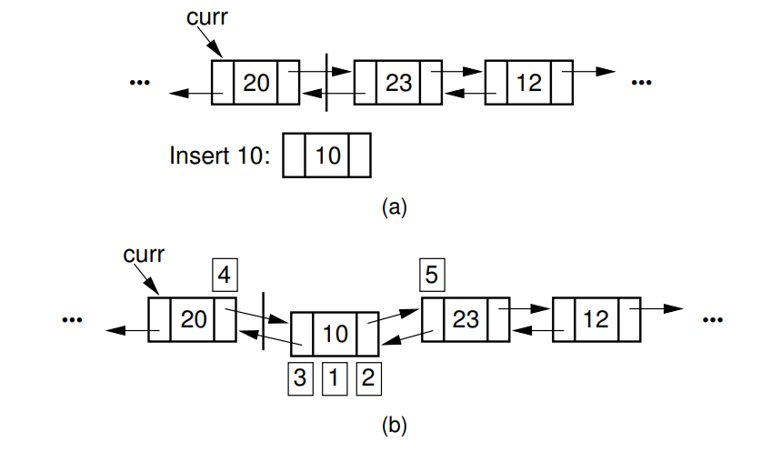
The class declaration and the remaining member functions for the doubly linked list class are nearly identical to the singly linked list version.
The insert method is especially simple for our doubly linked list implementation, because most of the work is done by the node’s constructor.

Slide 7
The labels 1,2, and 3 corresponds to assignments done by the linked list constructor.
Label 4, marks the assignment to curr→ next.
Label 5, marks the assignment to the prev pointer of the node following the newly inserted node.

Slide 8
The three parameters to the new operator allow the list node class constructor to set the element, prev, and next fields, for the new link node.
The new operator returns a pointer to the newly created node.
The nodes to either side have their pointers updated to point to the newly created node.
The existence of the header and tailer nodes mean that there are no special cases to worry about when inserting into an empty list.

Slide 9
The append method is also simple.
Again, the Link class constructor sets the element, prev, and next fields of the node when the new operator is executed.

Slide 10
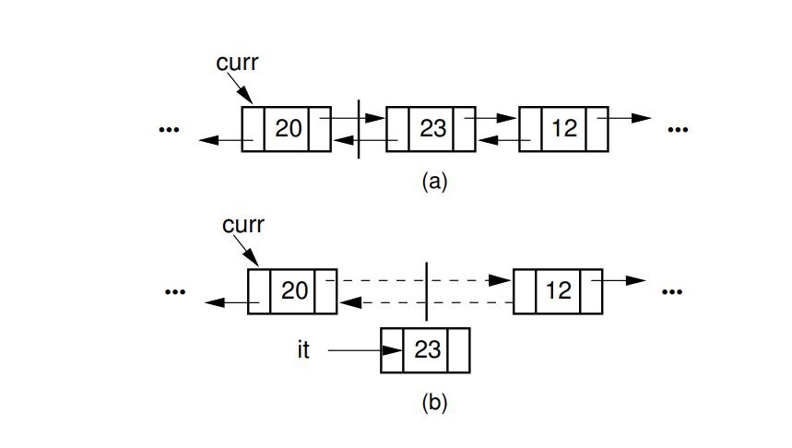
Method remove is straightforward, though the code is somewhat longer.
First, the variable it is assigned the value being removed.
Element it stores the element of the node being removed.
Then the nodes to either side have their pointers adjusted.

Slide 11

Note that we must separate the element, which is returned to the caller, from the link object.
The first line stores the value of the node being removed.
The second line makes the next node’s prev pointer point to the left of the node being removed.
Finally, the next field of the node preceding the one being deleted is adjusted.
The final steps of method remove are to update the list length and return the value of the deleted element.

Slide 12
The only disadvantage of the doubly linked list as compared to the singly linked list is the additional space used.
The doubly linked list requires two pointers per node, and so in the implementation presented it requires twice as much overhead as the singly linked list.

